Slide 1
Lecture
Managerial Accounting
6
L.O. 14-1: Managerial accounting basics
L.O. 14-2: Manufacturing cost concepts
L.O. 14-3: Manufacturing costs in financial statements
L.O. 14-4: Managerial accounting today

Slide 2
Learning Objective 14-1
Managerial Accounting Basics

Slide 3
Outline
Managerial and Financial accounting
Management functions
Organizational Structure

Slide 4
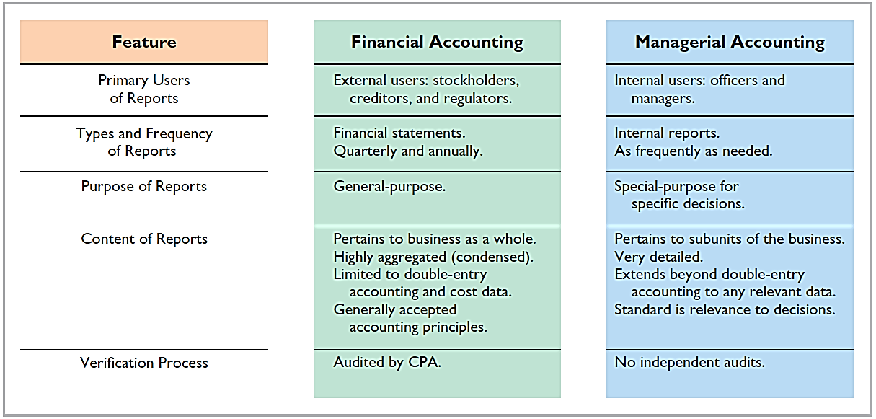
Review: Financial and Managerial Accounting

Slide 5
Managerial Accounting
Provides economic and financial information for managers and other internal users.
Comparing Managerial and Financial Accounting
Similarities:
Each field deals with economic events of a business
Both require that economic events be quantified and communicated to interested parties

Slide 6
Management Functions
Planning
Maximize short-term profit and market share
Commit to environmental protection and social programs
Add value to the business
Directing
Coordinate diverse activities and human resources
Implement planned objectives
Provide incentives to motivate employees
Hire and train employees
Produce a smooth-running operation
Controlling
Keep and maintain activities on track
Determine whether goals are met
Decide changes needed to get back on track
May use an informal or formal system of evaluations

Slide 7
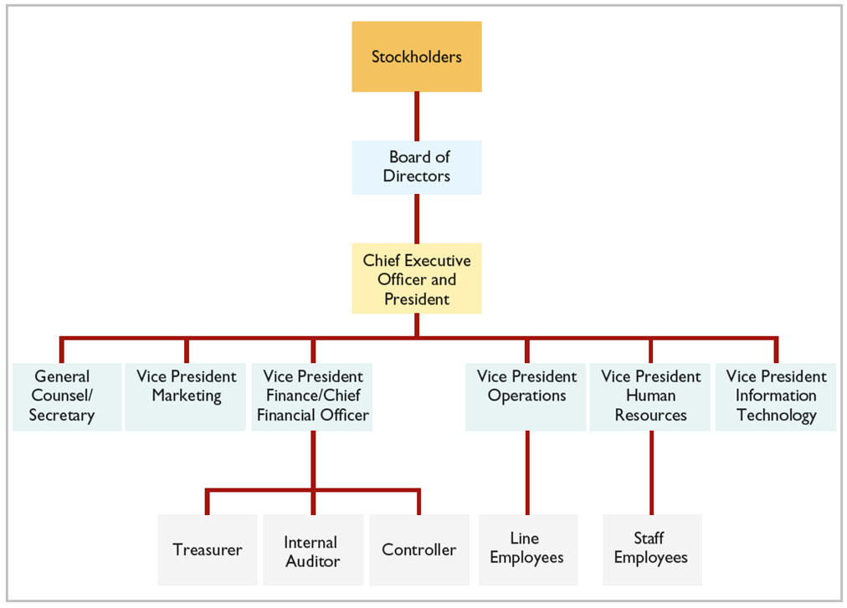
Organizational Structure

Slide 8
DO IT! 1: Managerial Accounting
Indicate whether the following statements are true or false.
1. Managerial accountants have a single role within an organization: collecting and reporting costs to management.
False
2. Financial accounting reports are general-purpose and intended for external users.
True
3. Managerial accounting reports are special-purpose and issued as frequently as needed.
True
4. Managers’ activities and responsibilities can be classified into three broad functions: cost accounting, budgeting, and internal control.
False
5. Managerial accounting reports must now comply with generally accepted accounting principles (GAAP).
False

Slide 9
Learning Objective 14-2
Manufacturing Cost Concepts

Slide 10
Outline
Manufacturing costs
Product costs vs. Period costs

Slide 11
Manufacturing Costs
Managers need useful information. A very important type of information relates to costs.
Managers should ask questions such as the following.
What costs are involved in making a product or providing a service?
If we decrease production volume, will costs decrease?
What impact will automation have on total costs?
How can we best control costs?

Slide 12
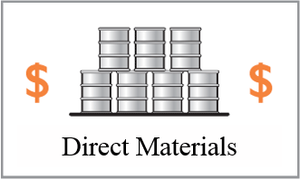
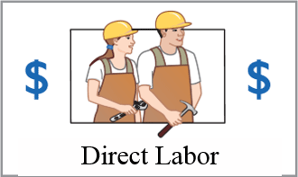
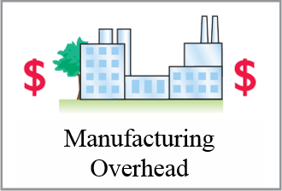
Manufacturing Costs
Manufacturing consists of activities and processes that convert raw materials into finished goods. Manufacturing costs are classified as:

Slide 13
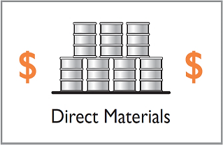
Direct Materials
Raw materials that can be physically and directly associated with the finished product during the manufacturing process.
Indirect Materials
Not physically part of the finished product or
They are an impractical to trace to the finished product because their physical association with the finished product is too small in terms of cost.
Considered part of manufacturing overhead.

Slide 14
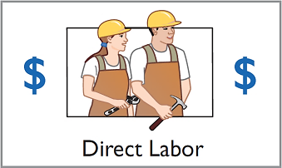
Direct Labor
Work of factory employees that can be physically and directly associated with converting raw materials into finished goods.
Indirect Labor
Work of factory employees that has no physical association with the finished product or for which it is impractical to trace costs to the goods produced.
Considered part of manufacturing overhead.

Slide 15
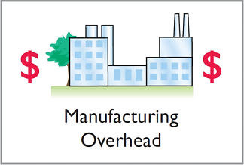
Manufacturing Overhead
Costs that are indirectly associated with manufacturing the finished product.
Includes all manufacturing costs except direct materials and direct labor.
It also includes depreciation on factory machines and buildings, and insurance, taxes, and maintenance on factory facilities.

Slide 16
Product Versus Period Costs
Product Costs
Direct materials
Direct labor
Manufacturing overhead
Components:
Costs that are an integral part of producing the product.
Recorded in “inventory” account.
Not an expense (COGS) until the goods are sold.

Slide 17
Product Versus Period Costs
Period Costs
Charged to expense as incurred.
Matched with revenue at a specific time rather than included as part of the cost of the product.
Non-manufacturing costs.
Includes all selling and administrative expenses.

Slide 18
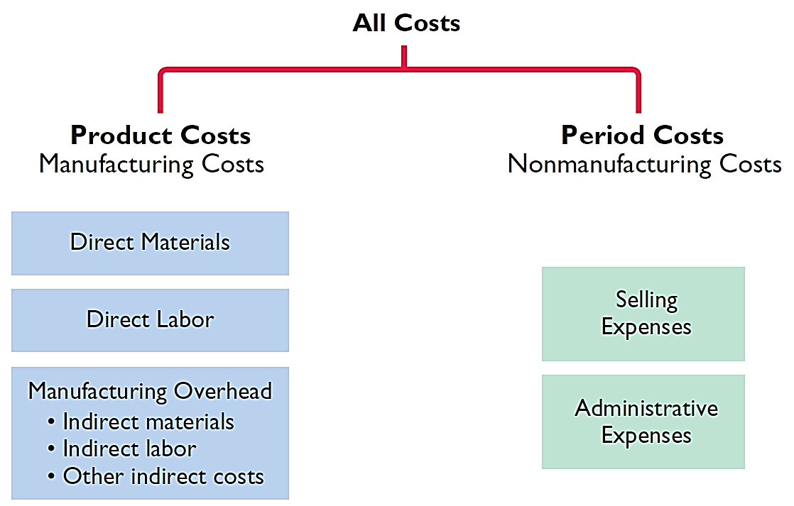
Product Versus Period Costs

Slide 19
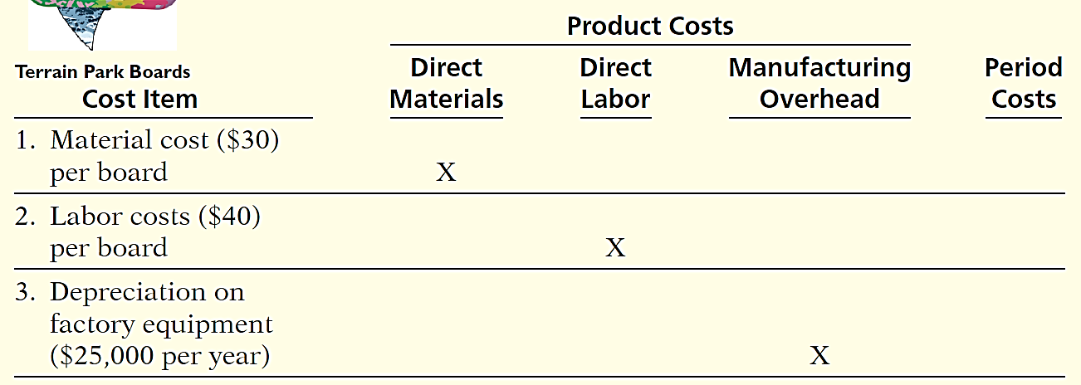

Product Versus Period Costs
Illustration: Suppose you started your own snowboard factory, KRT Boards. Here are some of the costs that your snowboard factory would incur. Assign the following costs:

Slide 20
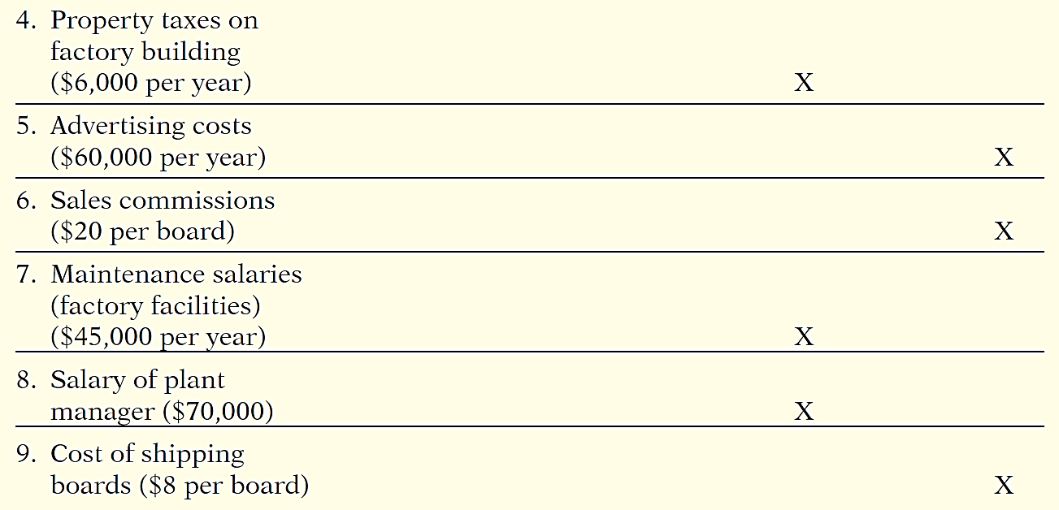
Product Versus Period Costs

Slide 21

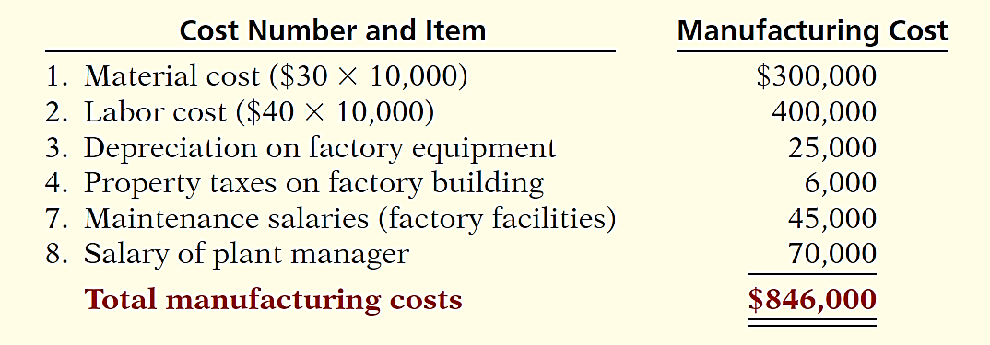
Product Versus Period Costs
If KRT Boards produces 10,000 snowboards the first year, what would be the total manufacturing costs?

Slide 22
DO IT! 2: Managerial Cost Concepts
Classify each of these costs for a bicycle company.
Cost | Product Cost | Period Cost
Tires | Direct materials
Wages of employees who put tires on the wheels | Direct labor
Factory building depreciation | Manufacturing overhead
Advertising expenditures |  | X
Factory machine lubricants | Manufacturing overhead
Spokes | Direct materials
Salary of factory manager | Manufacturing overhead
Salary of accountant |  | X
Handlebars | Direct materials
Salaries of factory maintenance employees | Manufacturing overhead
Salary of product quality inspector | Manufacturing overhead

Slide 23
Learning Objective 14-3
Manufacturing Costs in
Financial Statements

Slide 24
Outline
Balance sheet
Income statement
Cost of goods manufactured
Cost of goods manufactured schedule

Slide 25
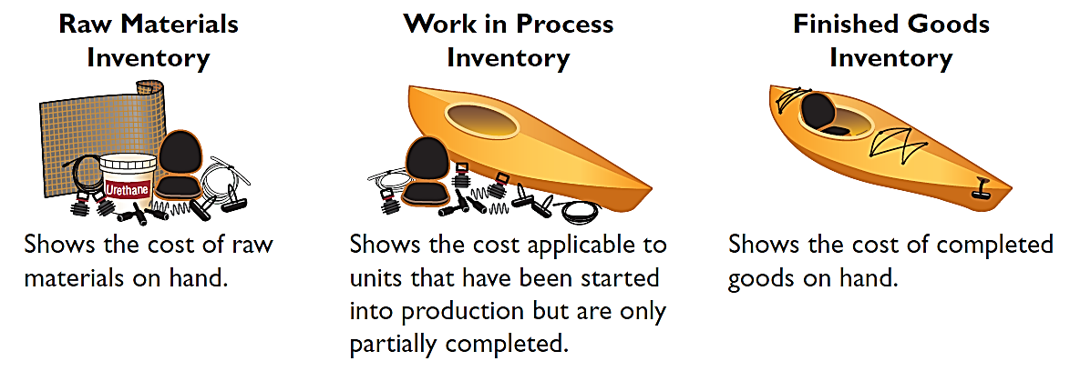
Balance Sheet
Inventory accounts for a manufacturer
The balance sheet for a merchandising company shows just one category of inventory.

Slide 26
Classifying Inventory
Merchandising Company
Manufacturing Company
One Classification:
Inventory
Three Classifications:
Raw Materials
Work in Process
Finished Goods
Ready for sale
Service companies do not carry any inventory

Slide 27
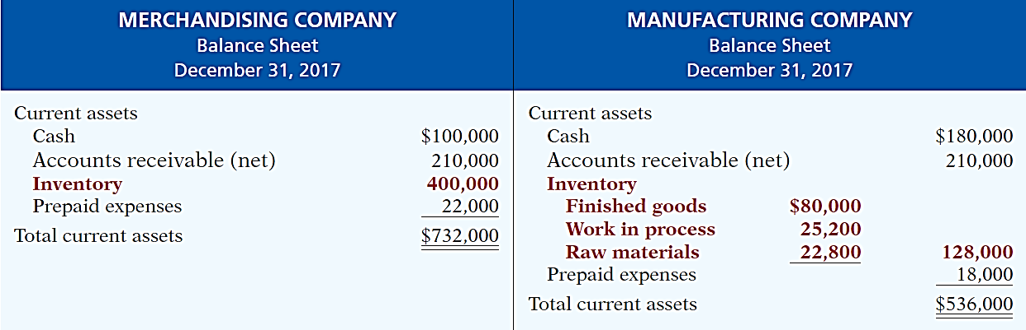
Balance Sheet
Current assets sections of merchandising and manufacturing balance sheets

Slide 28
Income Statement
Under a periodic inventory system, the income statements of a merchandiser and a manufacturer differ in the cost of goods sold section.
“COGS”

Slide 29
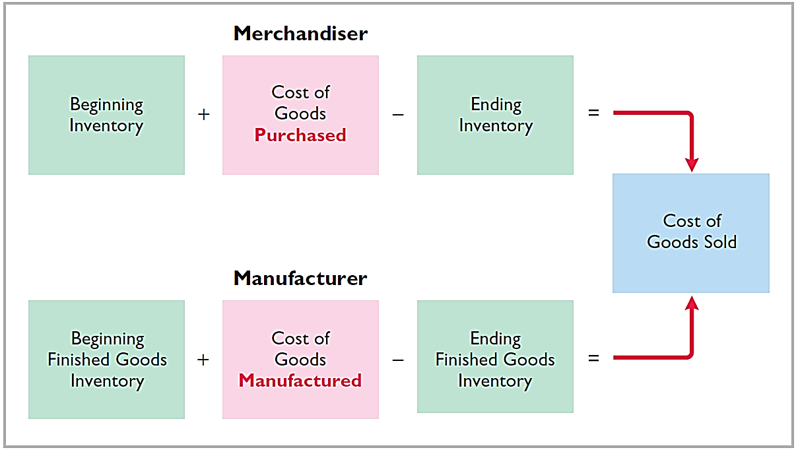
Income Statement

Slide 30
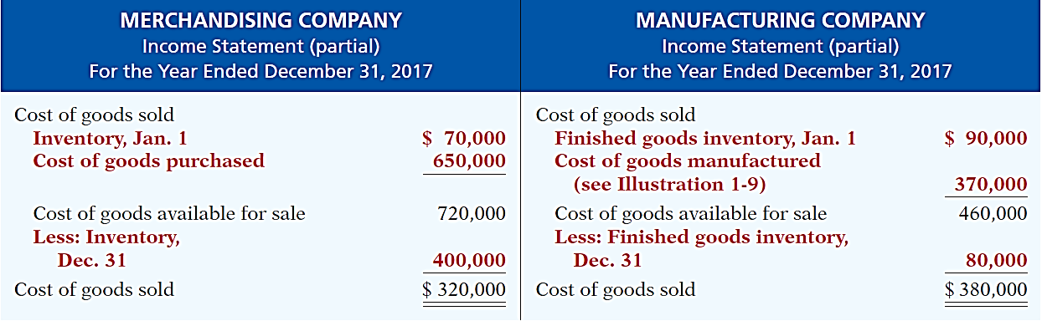
Income Statement
Cost of goods sold sections of merchandising and manufacturing income statements

Slide 31
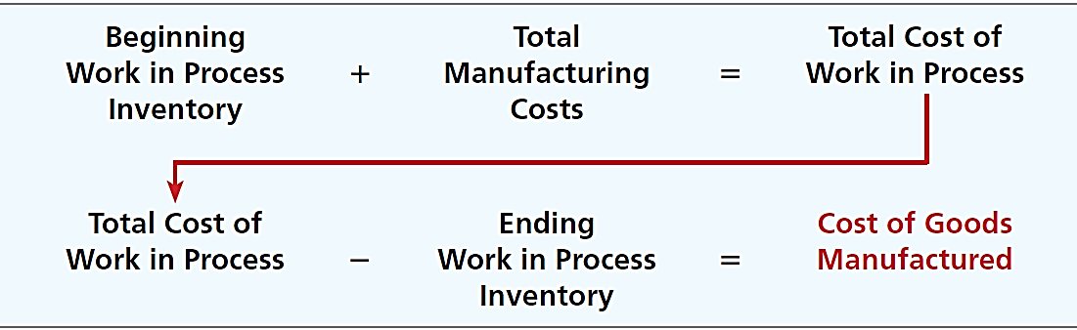
Cost of Goods Manufactured
Total Manufacturing Costs – sum of direct material costs, direct labor costs, and manufacturing overhead in the current year.
Total Work in Process – (1) cost of beginning work in process and (2) total manufacturing costs for the current period.

Slide 32
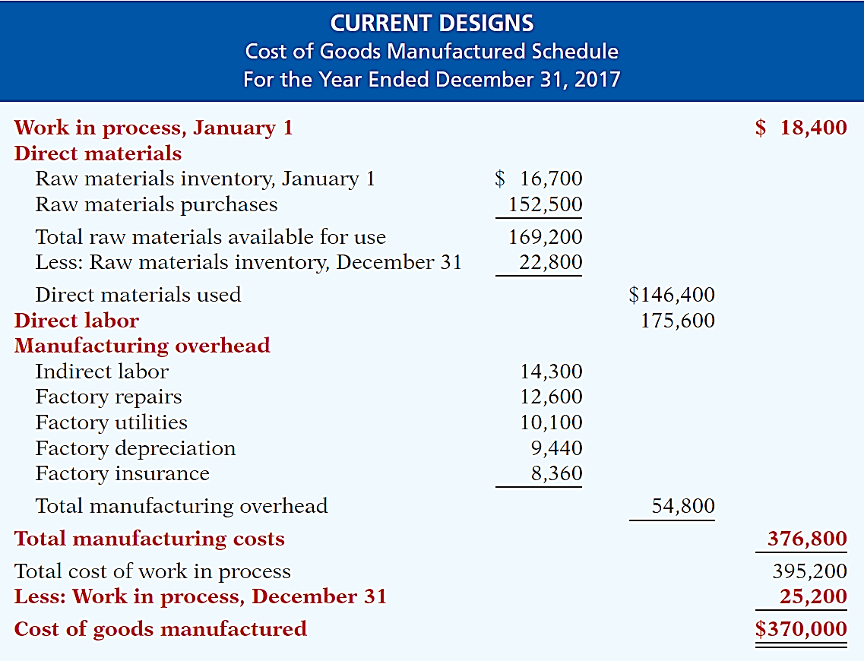

Slide 33
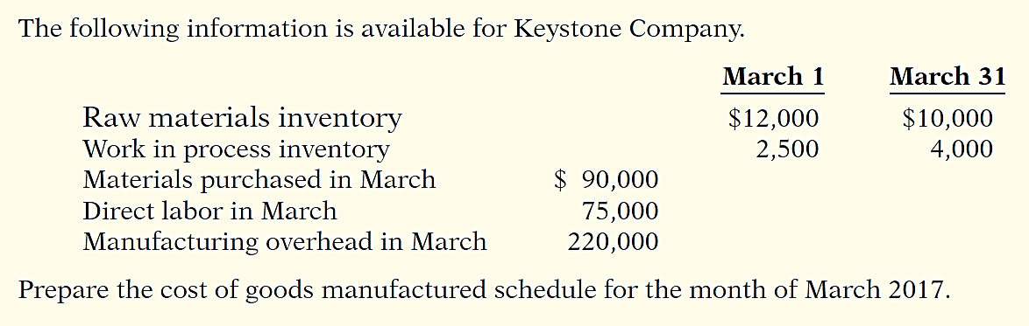
DO IT! 3: Cost of Goods Manufactured

Slide 34
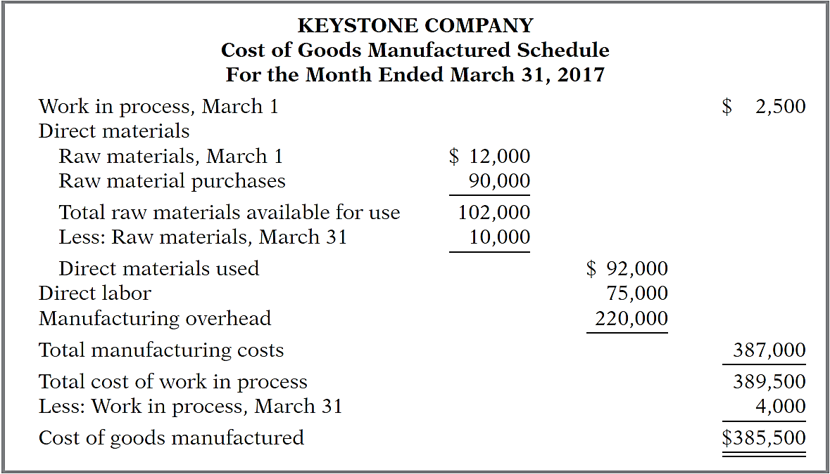
DO IT! 3: Cost of Goods Manufactured

Slide 35
Learning Objective 14-4
Managerial Accounting Today

Slide 36
Outline
Service Industries
Focus on the Value Chain
Balanced Scorecard
Business Ethics
Corporate Social Responsibility

Slide 37
Service Industries
Much of U.S. economy has shifted toward an emphasis on providing services rather than goods
Approximately 80% of U.S. workers are now employed by service companies
Most techniques learned for manufacturing firms are applicable to service companies

Slide 38
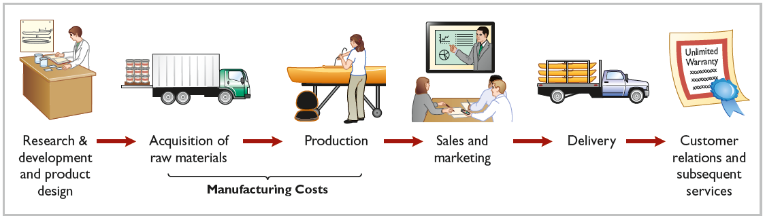
Focus on the Value Chain
Refers to all business processes associated with providing a product or performing a service
For a manufacturing firm, these include the following:

Slide 39
Focus on the Value Chain
Just-In-Time (J I T) Inventory Method
System in which goods are manufactured or purchased just in time for sale
Total Quality Management (T Q M)
System implement to reduce defects in finished products, with goal of zero defects

Slide 40
Focus on the Value Chain
Theory of Constraints
Constraints (“bottlenecks”) within the value chain that limit company’s potential profitability
A specific approach to identify and manage these constraints in order to achieve company goals
Enterprise Resource Planning (E R P)
Software programs designed to manage all major business processes

Slide 41
Focus on the Value Chain
Activity-Based Costing (A B C)
Allocates overhead based on each product’s use of activities
Results in more accurate product costing and increased efficiency in the value chain

Slide 42
Balanced Scorecard
Evaluates operations in an integrated fashion
Uses both financial and nonfinancial measures
Links performance in a cause-and-effect fashion ensure that they all tie to the company’s overall objectives

Slide 43
Business Ethics
All employees are expected to act ethically
Many organizations have codes of business ethics
Systems and controls sometimes create incentives for managers to take unethical actions
Controls need to be effective and realistic

Slide 44
Business Ethics
Code of Ethical Scandals
Sarbanes-Oxley Act (S O X)
Clarifies management’s responsibilities
Requires certifications by C E O and C F O
Selection criteria for Board of Directors and Audit Committee
Substantially increased penalties for misconduct

Slide 45
Corporate Social Responsibility
Considers a company’s efforts to employ sustainable business practices
Sometimes referred to as triple bottom line because it evaluates a company’s performance with regard to people, planet, and profit
Recent reports indicate that nearly 80% of the 500 largest U.S. companies provide sustainability reports

Slide 46
DO IT! 4: Trends in Managerial Accounting
All activities associated with providing a product or performing service.
Activity-based costing
Balanced scorecard
Corporate social responsibility
Just-in-time (JIT) inventory
Total quality management (TQM)
Statement of Ethical Professional Practice
Value chain
(g)
A method of allocating overhead based on each product’s use of activities in making the product.
(a)
Systems implemented to reduce defects in finished products with the goal of achieving zero defects.
(e)
A performance-measurement approach that uses both financial and nonfinancial measures, tied to company objectives, to evaluate a company’s operations in an integrated fashion.
(b)
Inventory system in which goods are manufactured or purchased just as they are needed for use or sale.
(d)

